Slide 1

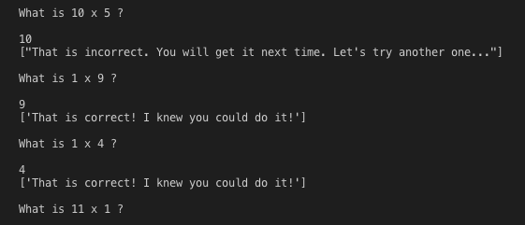
Gen Z Multiplication Flash Cards A software designed to adapt to Gen Z technological mathematics learning
Coders: Allison smith & paris vo

